Slide 1
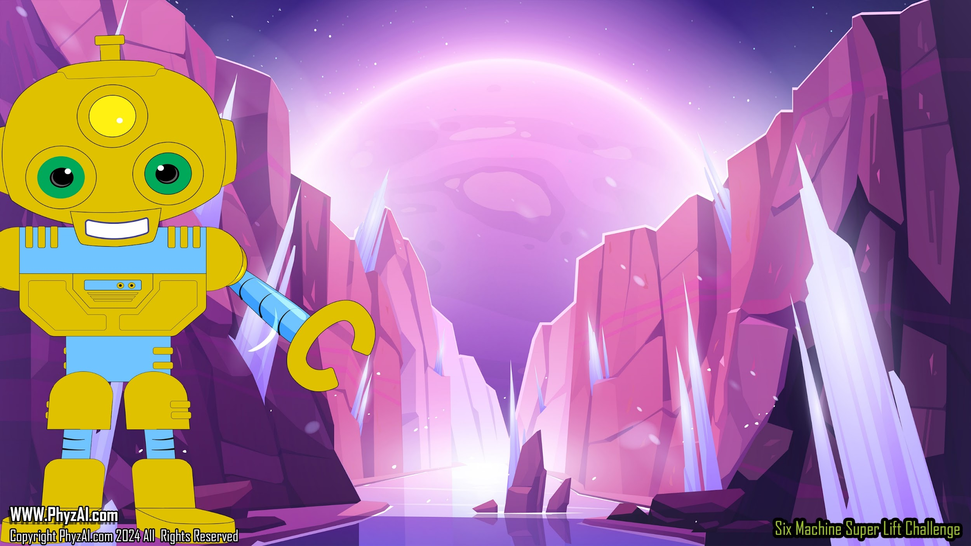
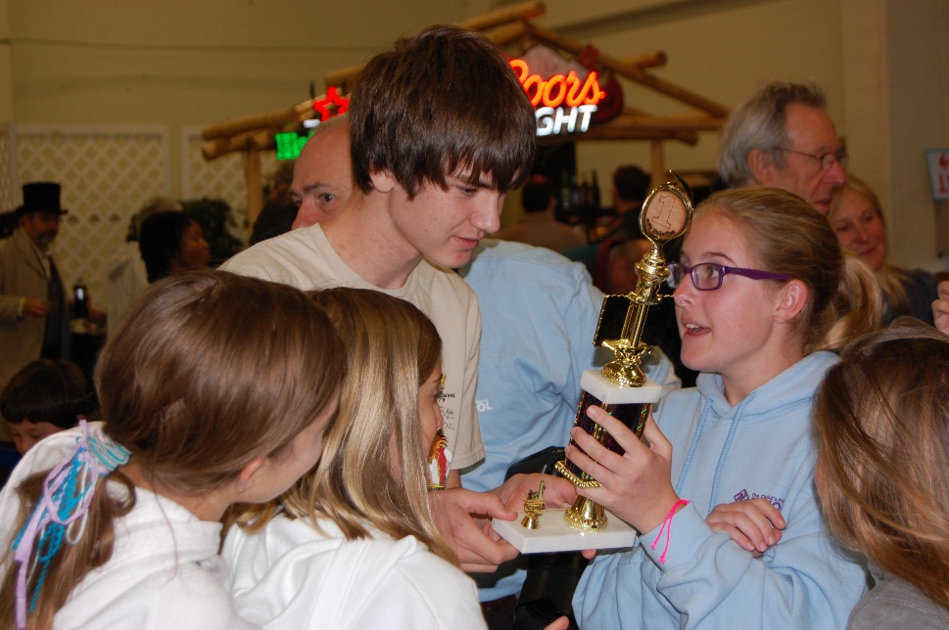
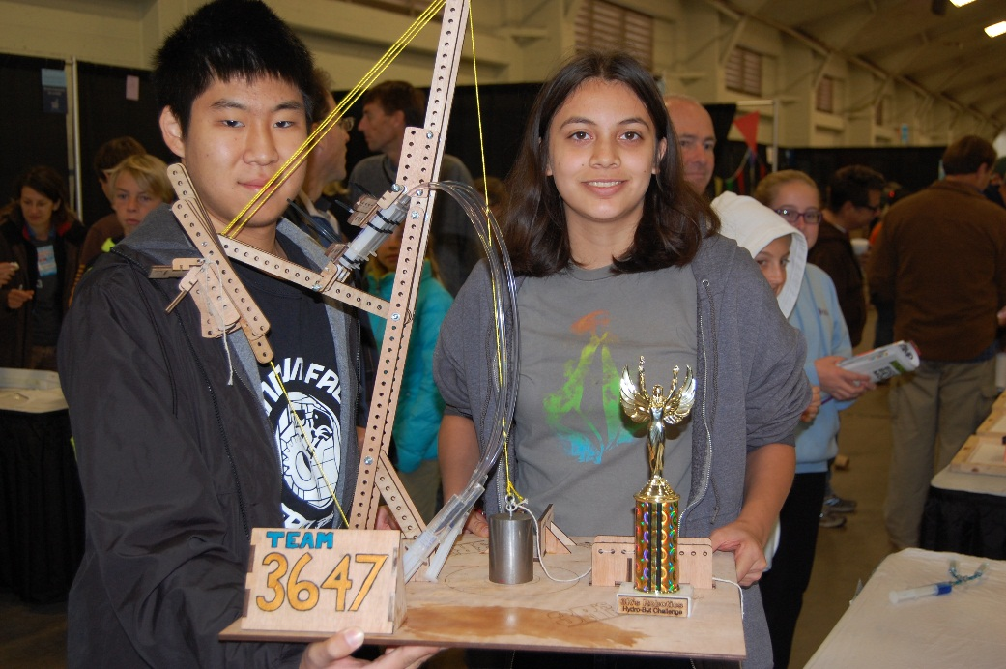
Six Simple Mechanical Machines in the Super-Lift Challenge
Wheels, Inclined Planes,
Wedges & Screws
Notes:
Welcome, future scientists and engineers! Today, we're embarking on a galactic adventure to use wheels, inclined planes, wedges, and screws in your Super-Lift design.

Slide 2

Six Simple Machines
Wh
E
E
L
Load
Effort
Effort
Effort
LEVER
Axel
FULCRUM
Load
Load
Load
Effort
Wedge
Effort
Effort
Load
Load
Load

Slide 3

Wheels
W
h
E
E
L
Effort
Axel
Load
Notes:
A wheel and an axle is a simple machine consisting of an axle attached to the center of a larger wheel so that the wheel and the axle rotate together. Doorknobs, wrenches, Ferris wheels, screwdrivers, and stirring wheels are all examples of wheels and axles.

Slide 4

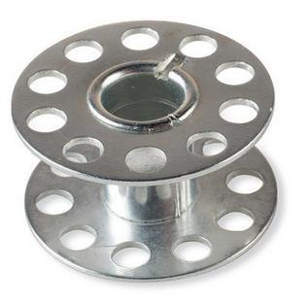
A wheel is a circular component that is intended to rotate on an axial bearing.
For the Super-Lift Challenge, we use
metal sewing bobbins for our wheels.
Notes:
You may notice in your kits these circular bobbins. These are examples of wheels for your Super-Lift. They can also be incorporated into the pulley designs.

Slide 5

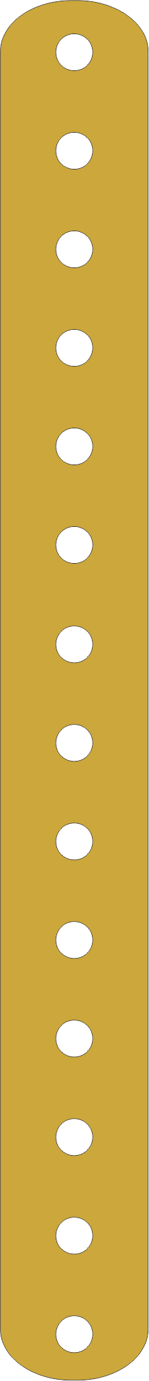
A wheel can be used
to reduce friction
when changing the direction of tackle.
Notes:
Wheels can be incorporated into your Super-Lift design to reduce friction in the overall system. This allows the transmission of force to happen more efficiently when lifting a load.

Slide 6
A wheel can be used to make components roll more easily, allowing you to reduce the effort needed to move a load.
Notes:
Have you ever noticed how objects with wheels are a lot easier to move than objects that we have to slide across the floor? That's because it takes a lot less force to move objects that are on wheels than objects that are not on wheels. So utilize this in the overall design of your Super-Lift where you can.

Slide 7

A wheel can be used as part of a more complex system, allowing the axle to become part of the machine.
W
h
E
E
L
Effort
Axel
Load
Notes:
A wheel can be used as part of a more complex system, allowing the axle to become part of the machine.

Slide 8
Inclined Plane
Effort
Load
Notes:
Inclined planes are simple machines that are straight, slanted surfaces. A ramp is a great example of an inclined plane.

Slide 9

An inclined plane is a flat, supporting surface tilted at an angle, with one end higher than the other, used as an aid for raising or lowering a load.
Effort
Notes:
Consider the following example of trying to load a refrigerator into the back of a truck. You might find that it requires a lot less effort force to push or pull the refrigerator up an inclined plane than it does to lift the refrigerator straight up and into the back of the truck.

Slide 10
Consider combining an inclined plane with other simple machines to move or lift your load.
Notes:
Now, let's get back on the example of loading a refrigerator into the back of a truck. The work you do on the refrigerator pushing it up the inclined plane is the same as the work you had to do to lift it straight up into the truck. However, the inclined plane basically allowed us to apply a smaller force over a greater distance when getting it up into the truck. This allowed us a lot more mechanical advantage.
Of course, combining inclined planes with other simple machines to move or lift the load gives you even more mechanical advantage than one or the other alone.

Slide 11
Wedge
Effort
Wedge
Load
Load
Notes:
A wedge is a double inclined plane that moves. Examples include doorstops, knives, chisels, and plows.

Slide 12
A wedge is a triangular-shaped tool that can be used to separate two objects or portions of an object, lift up an object, or hold an object in place. It functions by converting a force applied to its blunt end into forces perpendicular (normal) to its inclined surfaces.
Not all wedges are used to cut.
Sometimes we can use the force of a wedge for other purposes.
Notes:
Space explorers, Picture this: a wedge, shaped like a mighty triangle, ready to tackle any challenge in the vast expanse of the cosmos. Now, what does this trusty tool do? Well, it's a master of separation, lifting, and holding!
Imagine you've got two objects or parts of an object stubbornly stuck together. That's where the wedge swoops in like a hero, gently prying them apart. But its talents don't stop there! Need to lift something heavy? The wedge has got your back, using its shape to hoist objects with ease.
And let's not forget about its superpower of stability. Place a wedge just right, and it'll hold your gear in place like a cosmic anchor. But how does it work, you ask? Simple! When you push on the blunt end of the wedge, it transforms that force into perpendicular forces, kind of like magic, making it a versatile tool for all sorts of cosmic tasks.
Now, here's the kicker: not every wedge is out to slice and dice. Nope, some wedges are on a mission for more peaceful purposes. Instead of cutting, they harness the power of force for lifting, separating, and securing. So, whether you're building a spaceship or rearranging the stars, remember the mighty wedge—it's more than just a sharp edge!

Slide 13

Screw
Load
Effort
Notes:
A screw is an inclined plane wrapped in a spiral around the cylindrical post. Examples include lids to jars, bolts, threaded nuts, and even water lifting devices used by Archimedes back in the third century BC.

Slide 14
A screw is a mechanism that converts rotational motion to linear motion, and a torque (rotational force) to a linear force.
Notes:
It is important to point out that with screws, the mechanical advantage is related to the spacing of the threads. The mechanical advantage is larger if the threads are closer together. However, it takes more turns of the screw to drive into a material or to do the work of lifting a load.

Slide 15
Can you spot
all the simple machines used in these Super-Lift entries?
Notes:
Take a moment to see how many simple machines you can identify in the following Super-Lift entries. Remember, it is important that you utilize as many of these simple machines into your design as you can.

Slide 16



Slide 17
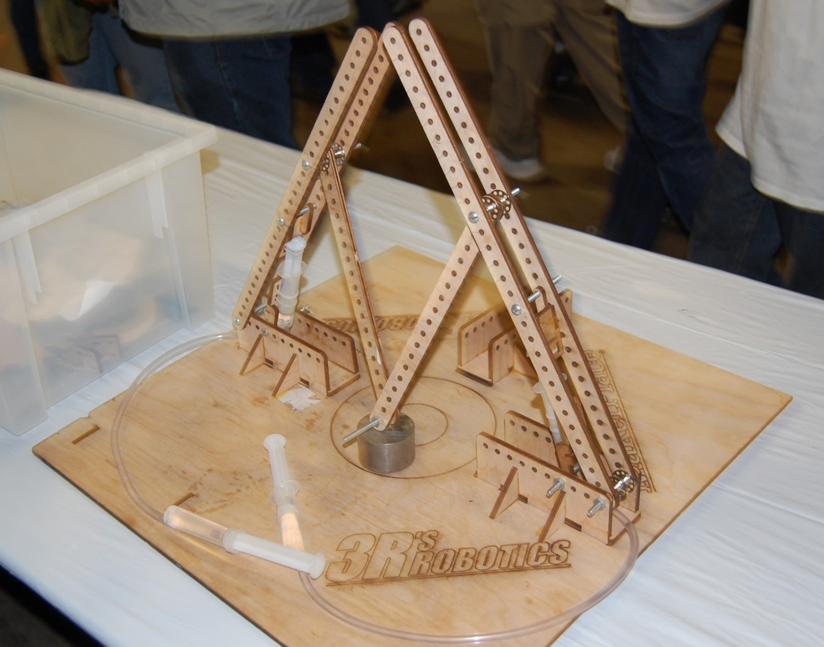

Slide 18
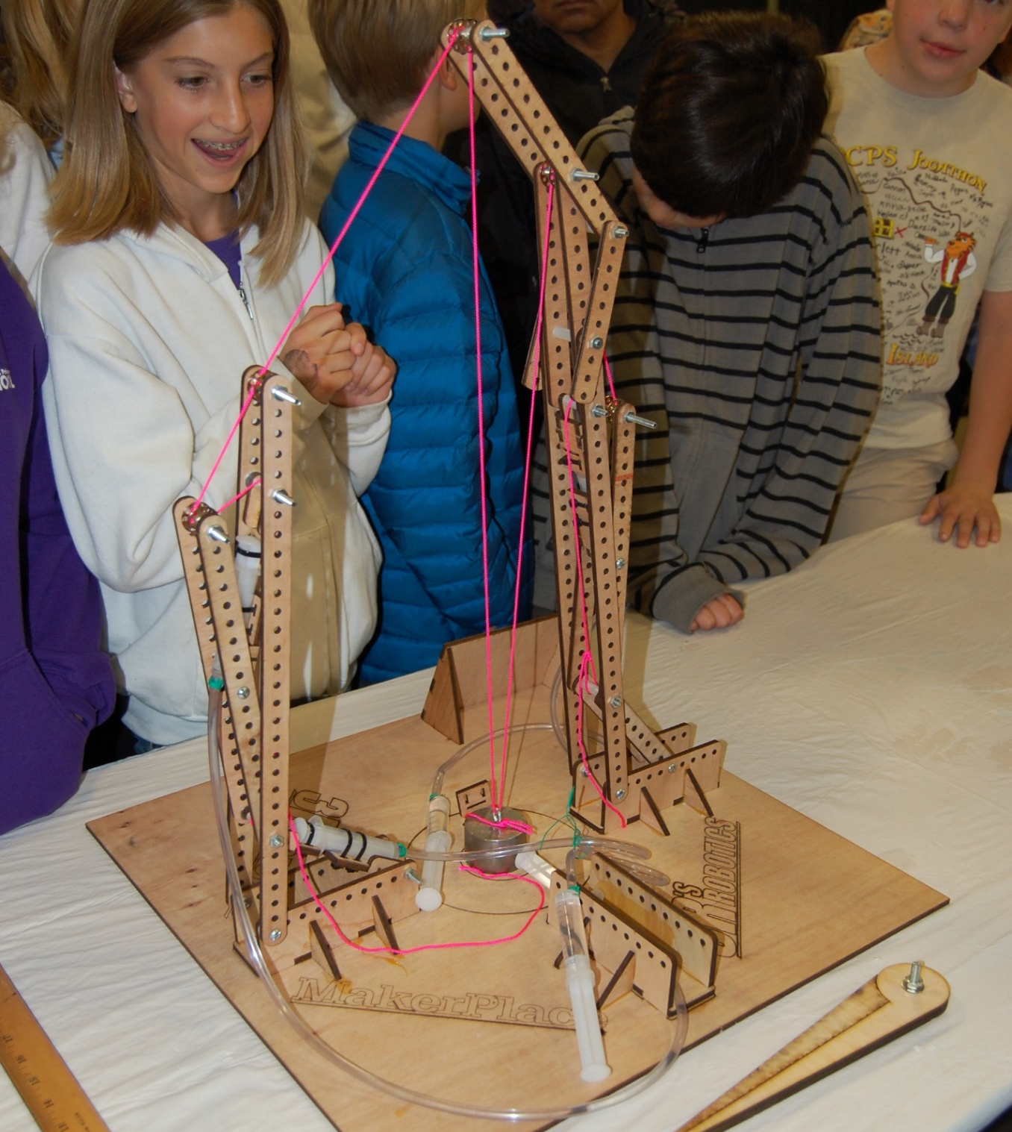

Slide 19

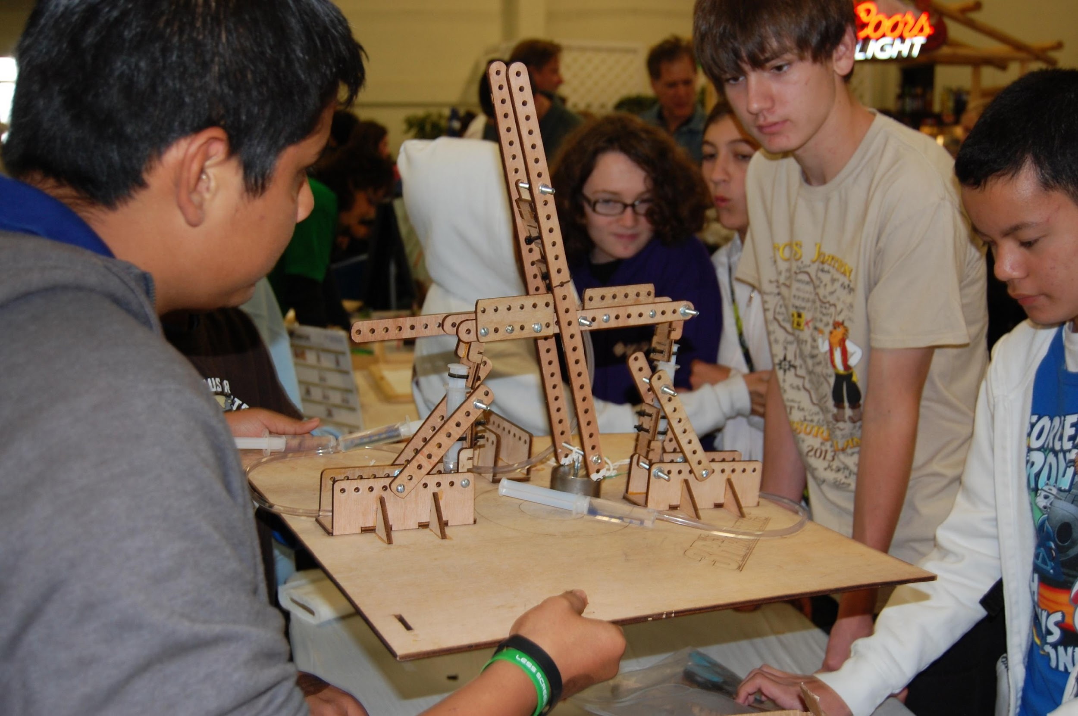

Slide 20
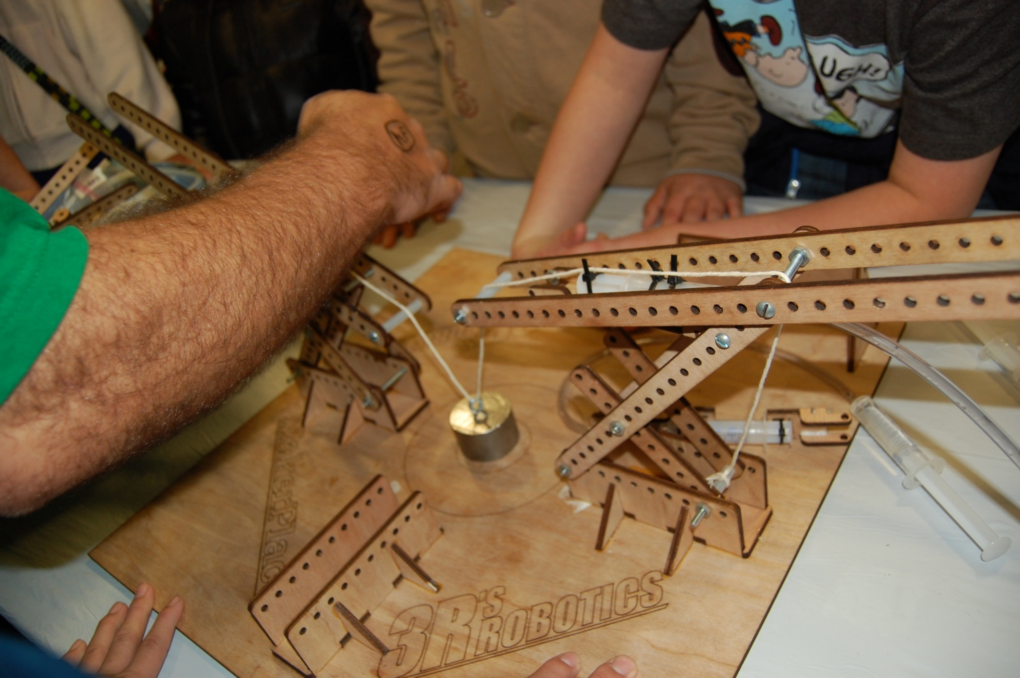

Slide 21
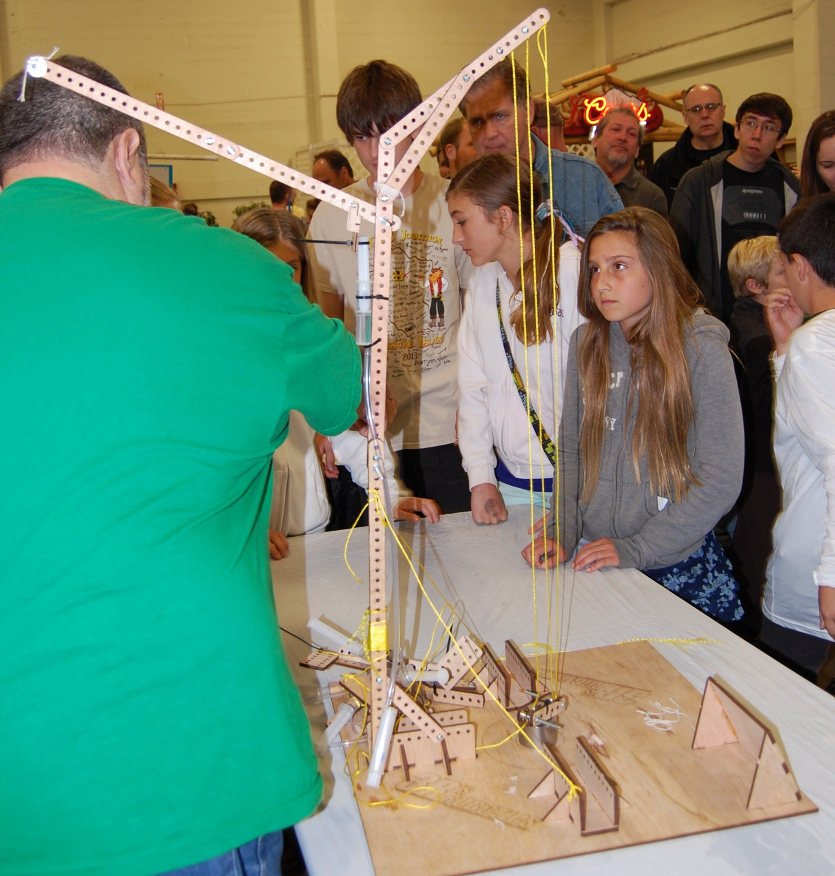

Slide 22
Winning teams always use components from all of the six simple machines.
Notes:
When it comes to building your Super-Lift designs, we're not just relying on one simple machine—we're tapping into the power of all six! Now, are you ready to join the cosmic challenge and create something truly out of this world?

